Slide 1
Weekly Report
11/21/22
Erin Ingram & Omar Mahmood
NanoBio Systems Lab
Texas A&M University

Slide 2
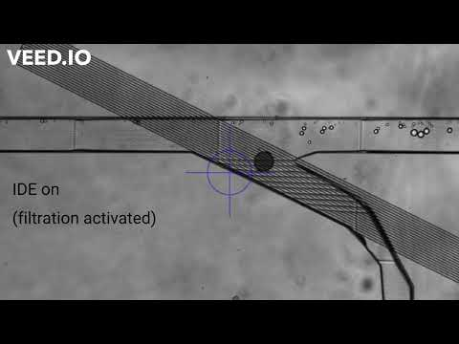
Progress
Experimentation with high-pass filter device
Video:

Slide 3
Goals for next week
Correct high-pass printing error (Nanoscribe not printing last ~25µm of channel height), adjust CAD design to be 25µm taller
Widen large droplet output channel to alleviate droplet build-up
Re-print high pass channel
Begin experiment for band-pass filter device

Slide 4
Thank you for your time!

